Slide 1
Operating System Overview
Chapter 2

Slide 2
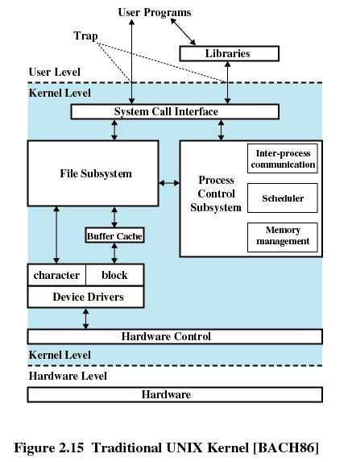
Operating System Overview
A program that controls the execution of application programs
An interface between applications and hardware

Slide 3
Operating System Objectives
Convenience
  Makes the computer more convenient to use
Efficiency
  Allows computer system resources to be used in an efficient manner
Ability to evolve
  Permit effective development, testing, and introduction of new system functions without interfering with service

Slide 4
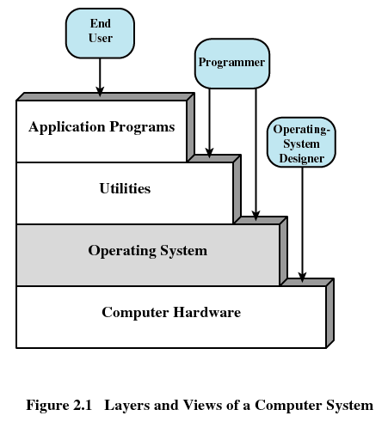
Layers of Computer System

Slide 5
Services Provided by the OS
Program development
  Editors and debuggers
Program execution
Access to I/O devices
Controlled access to files
System access

Slide 6
Services Provided by the OS (cont.)
Error detection and response
  Internal and external hardware errors
    Memory error
    Device failure
  Software errors
    Arithmetic overflow
    Access forbidden memory locations
  Operating system cannot grant request of application

Slide 7
Services Provided by the OS (cont.)
Accounting
  Collect usage statistics
  Monitor performance
  Used to anticipate future enhancements
  Used for billing purposes

Slide 8
Kernel (核心/内核)
Portion of operating system that is in main memory
Contains most frequently used functions
Also called the nucleus (核心)

Slide 9
Evolution of an OS
Hardware upgrades plus new types of hardware
New services
Fixes

Slide 10
Evolution of OS (cont.)
Serial Processing
  No operating system
  Machines run from a console with display lights, toggle switches, input device, and printer
  Schedule time
  Setup included loading the compiler, source program, saving compiled program, and loading and linking

Slide 11
Evolution of OS (cont.)
Simple Batch Systems
  Monitors
    Software that controls the sequence of events
    Batch jobs together
    Program branches back to monitor when finished
  Job Control Language (JCL)
    Special type of programming language
    Provides instruction to the monitor

Slide 12
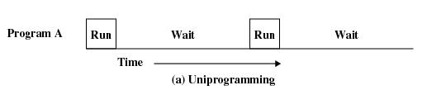
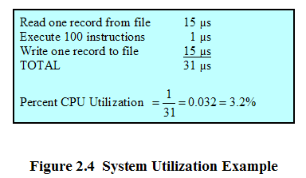
Evolution of OS (cont.)
Uniprogramming (单任务)
Processor must wait for I/O instruction to complete before preceding

Slide 13
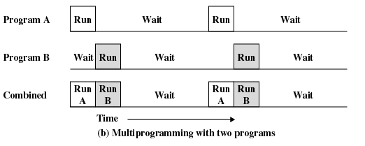
Evolution of OS (cont.)
Multiprogramming (多道/多任务)
When one job needs to wait for I/O, the processor can switch to the other job

Slide 14
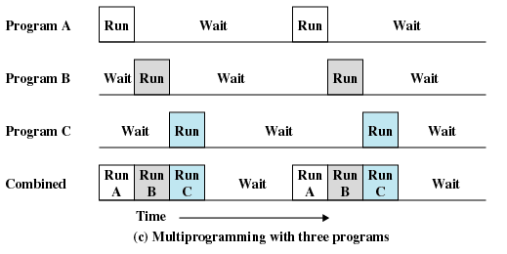
Evolution of OS (cont.)

Slide 15
Evolution of OS (cont.)
Using multiprogramming to handle multiple interactive jobs
Processor’s time is shared among multiple users
Multiple users simultaneously access the system through terminals

Slide 16
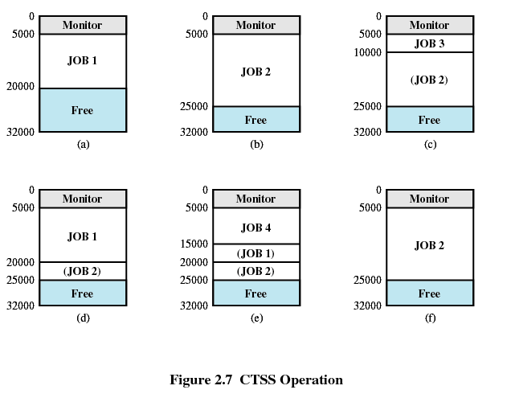
Evolution of OS (cont.)
Time Sharing
First time-sharing system developed at MIT

Slide 17
Modern Operating Systems
Microkernel architecture
  Assigns only a few essential functions to the kernel
    Address spaces
    Interprocess communication (IPC)
    Basic scheduling

Slide 18
Features of Modern Operating Systems
Multithreading
  Process is divided into threads that can run concurrently
    Thread
      Dispatchable unit of work
      executes sequentially and is interruptable
    Process is a collection of one or more threads
Symmetric multiprocessing (SMP)
  There are multiple processors
  These processors share same main memory and I/O facilities
  All processors can perform the same functions

Slide 19
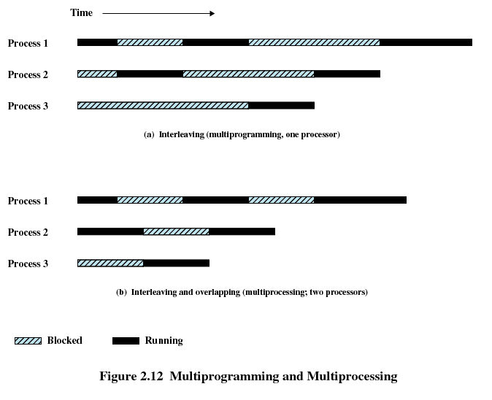
Multiprogramming and Multiprocessing

Slide 20
Modern Operating Systems
Distributed operating systems
  Provides the illusion of a single main memory space and single secondary memory space
Object-oriented design
  Used for adding modular extensions to a small kernel
  Enables programmers to customize an operating system without disrupting system integrity

Slide 21
Windows Architecture
Modular structure for flexibility
Executes on a variety of hardware platforms
Supports application written for other operating system

Slide 22
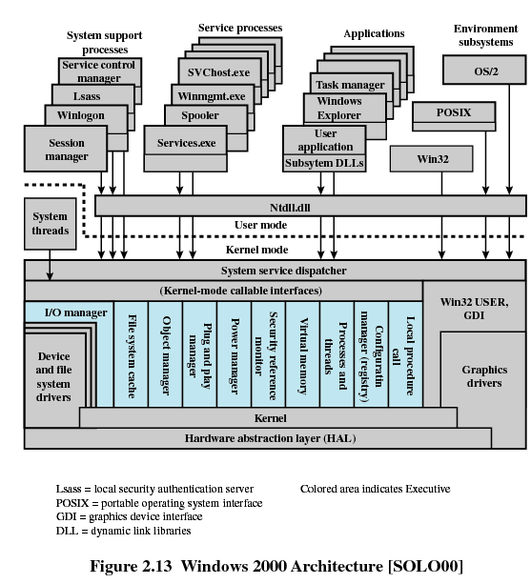
Windows 2000 Architecture

Slide 23
Traditional UNIX
Hardware is surrounded by the operating system software
Operating system is called the system kernel
Comes with a number of user services and interfaces
  Shell
  Components of the C compiler

Slide 24
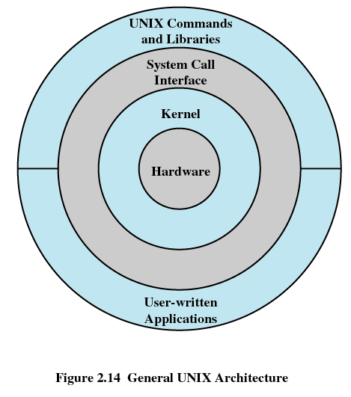
Traditional UNIX

Slide 25
Traditional UNIX Kernel

Slide 26
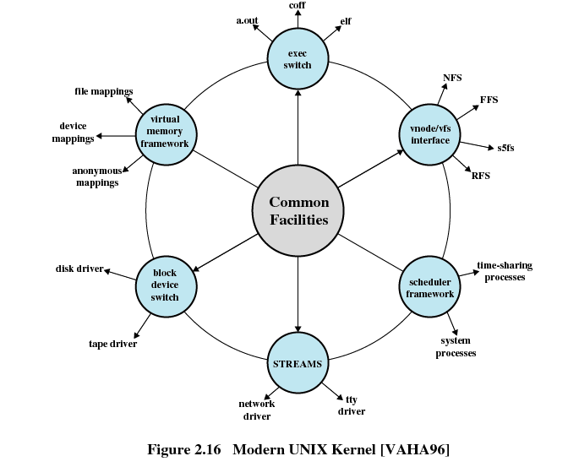
Modern UNIX Kernel

Slide 27
Modern UNIX Systems
System V Release 4 (SVR4)
Solaris 9
4.4BSD
Linux

